Slide 1
How Metabolic Syndrome Impacts Healthcare Costs
Notes:
Introduce Speaker: Dr. Traci Biondi, role and credentials
Prominence Health, who we are, where we work, and why we care.
“Prominence is made up of local people who shop where you shop, our kids & grandkids go to the same schools, we walk our dogs in the same parks, and use the same health system. We want the same thing you do – to have a healthy, safe and thriving community.”

Slide 2

Metabolic Syndrome
Overweight vs. Obese
Chronic Disease
Co-morbidities
Healthspan vs. Lifespan
Healthy Workplace
Notes:
Metabolic Syndrome – According to National Institute of Health (NIH), metabolic syndrome is defined as a clustering of abdominal obesity, dyslipidemia, hyperglycemia, and hypertension. While not all obese people have metabolic syndrome, all people with metabolic syndrome are at a two-fold increased risk of coronary heart disease, cerebrovascular disease, and a 1.5-fold increase in the risk of all-cause mortality.
Overweight vs Obese – For adults, the World Health Organization (WHO) defines overweight as a BMI greater than or equal to 25 and obesity is a BMI greater than or equal to 30.
Chronic disease – is a health condition or disease that is persistent or otherwise long-lasting in its effects. Metabolic Syndrome greatly raises the risk of developing diabetes, heart disease and stroke.
Co-morbidities – a disease or medical condition that is simultaneously present with another or others in a patient. Obesity or metabolic syndrome are not always caused by diet and lifestyle. In some cases, social determinants of health, genetics and taking certain medications also play a role.
Healthspan vs Lifespan – Lifespan is the total number of years we live whereas Healthspan is how many of those years we remain health and free from disease.
Healthy workplace – Where health promotion is the combined efforts of employers, employees, and society working to improve the mental and physical health and well-being of people at work.

Slide 3

Healthy is not “one size fits all”
Notes:
When considering how each of us can help create a “healthy workplace” its important to keep in mind that lifestyle is a large piece of the puzzle, but not the entire thing.
Genetics: Genes play a role in how your body stores and uses fat. Some people have a genetic predisposition to be more susceptible to weight gain.
Medications: Certain medications, like steroids, antidepressants, and some diabetes medications, can have weight gain as a side effect.
Illness & Medical Conditions: Some medical conditions, such as Cushing's syndrome and polycystic ovary syndrome (PCOS), can disrupt hormones and metabolism, leading to weight gain.
Stress: Chronic stress can elevate cortisol levels, a hormone that can increase appetite and promote fat storage.
One of the great values – in my opinion -- of The Chamber hosting this Coalition, is that we are all gaining Health Literacy.
The value of health literacy – is that it’s not about Blame and Shame it’s about Supporting & Empowering employees to contribute to their own wellbeing.
While it’s exciting that research into health is growing – and social movements about aspects of health, such as nutrition -- it can be very confusing and overwhelming.
Examples:
Don’t eat red meat! It’ll give you cancer.
Don’t eat vegetarian! You’ll have nutritional deficiencies.
Today presentation is to help you increase your “Health Literacy” to understand the hidden costs that employee metabolic syndrome and obesity have on your business.
As a local health plan, we are here to support you -- as the employer -- and health plan members on their health journey.

Slide 4
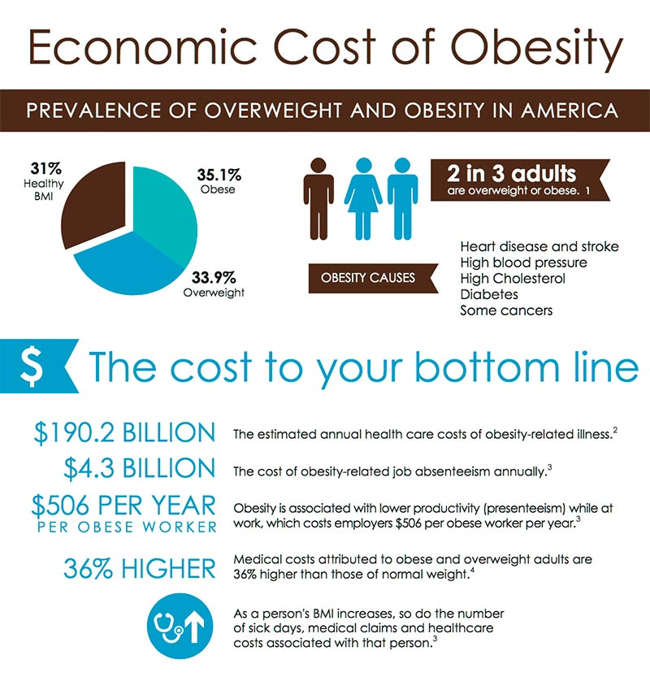
Notes:
The aggregate medical costs of obesity are estimated to be more than $200 billion annually.
Among the overweight, medical costs can be reduced by $2,200 to $5,300 following a 10% reduction in body weight.

Slide 5
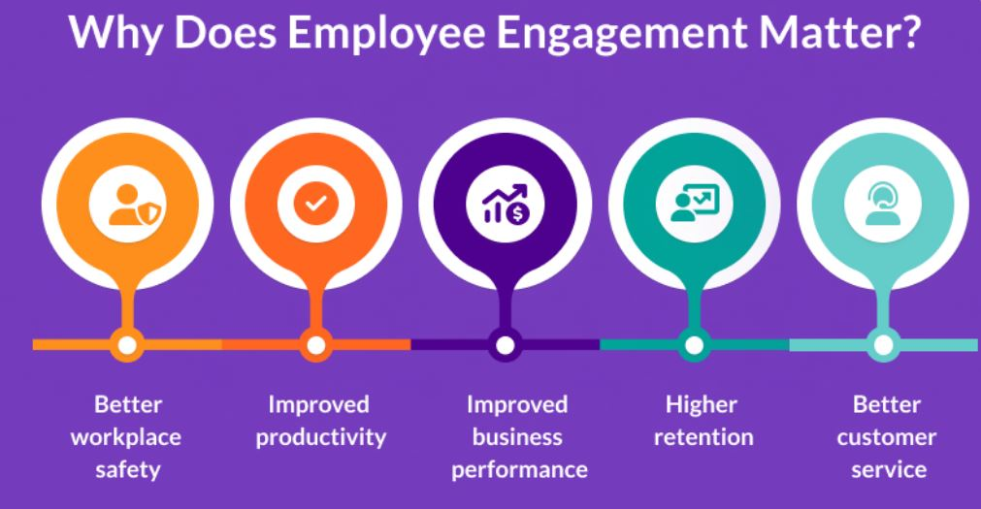
How does an engaged vs. non-engaged workforce show up in your business?
Notes:
Absenteeism 66% more than non-obese.
Reduced productivity (presenteeism) costs range from $429-$3,341
Mental health affects 71% of workforce (including mental illness, stress, anxiety, etc.)
Healthcare cost trends are projected to increase about 8.9% in 2024
Insurance premiums (need stats to support how obesity impacts insurance premium)

Slide 6
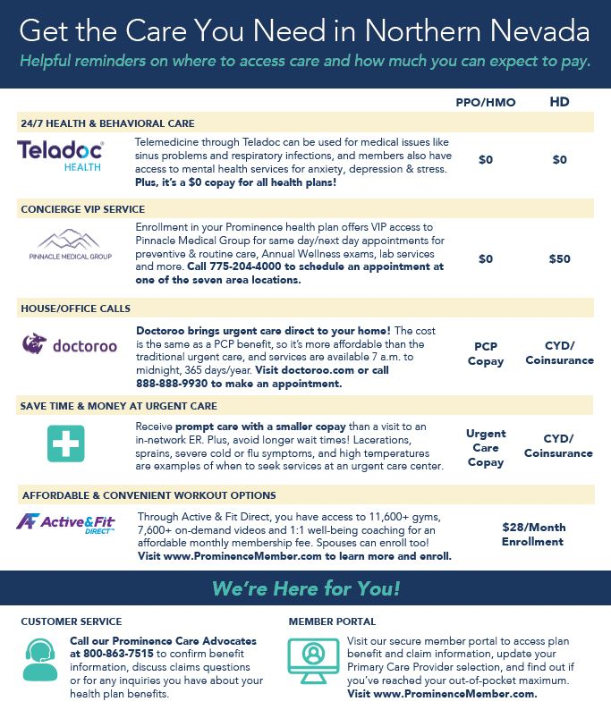
Empowering Employees to create a healthy workplace, doesn’t have to be expensive or complicated.
Notes:
*add in photo of posters we just printed
Start with what you already have in place:
Educate employees to understand “levels of care” – Urgent Care/ER is not your PCP.
Educate employees on their health insurance preventative benefits.
Promote online mental health telemedicine as a convenient and cost-effective alternative.

Slide 7
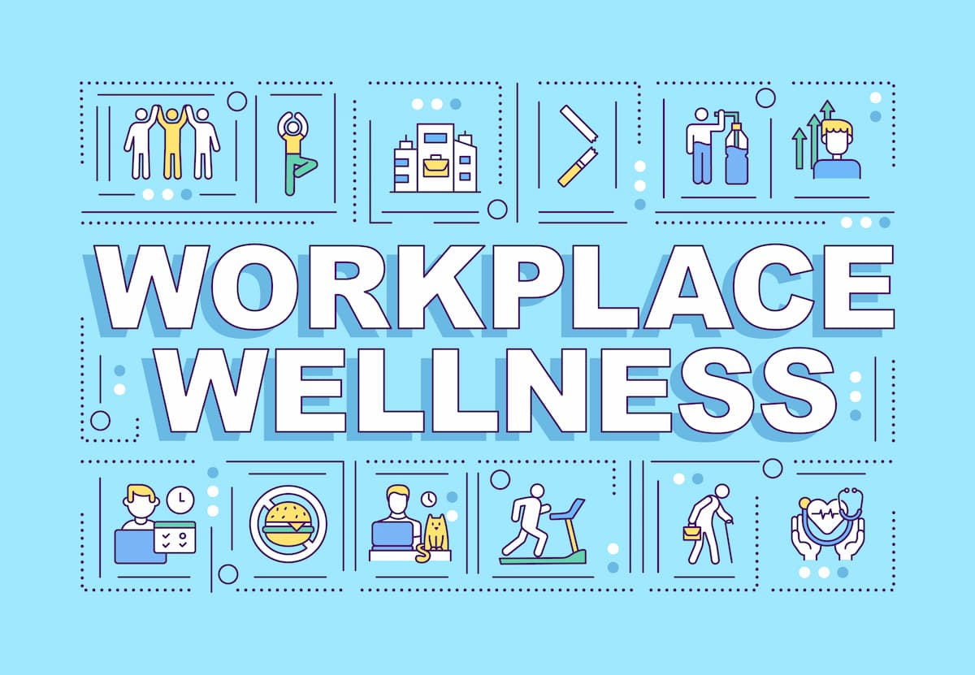
Ready to dip your toe into a workplace wellness program?
Notes:
Host on-site health fairs for employees and their families
Provide healthy snack & drink options in the breakroom
For those employers ready to invest more upfront for results down the road…
Employee-led wellness is more successful than top-down; Find a wellness champion.
Encourage and support regular stretching/movement/walk/sunshine breaks.
[Promote RSCC’s 1,000,000 Step Challenge]
Cash talks – employee incentives can help drive down costs.
Invest in an evidence-based wellness program. These can be general health, mental health, diabetes-focused, nutrition focused, etc.

Slide 8

Take the QUIZ
“How are YOU?”
https://www.nhs.uk/better-health/how-are-you-quiz/
Notes:
https://www.nhs.uk/better-health/how-are-you-quiz/
It’s hosted by the National Health Services in the UK but as long as you can get past the British terms, it’s actually a really good quiz. The best part is at the end, your employees will receive a health score and actionable resources for areas to improve. Such as moving more, eating healthier, drinking less, smoking cessation, sleeping better, and managing their weight.

Slide 9
Q&A

